Slide 1
Block Chain --Om Prakash Lalchandani B.Tech (CS),PMP,LLM,MBA(IT)

Slide 2
About Me Om.lalchandani
B.Tech (CS) – 1990 Gold Medallist LLB (1997), PMP, PhD (robotics)
Currently working as Director Operations
Development of Covid-19 Robots
Worked for brands like IBM, Mphasis, StanChart, InfoSys, Symbiosis
Undertake Regular Corporate as well as Academic Trainings for Top brands
Regular Live sessions at National TV Channels and Radio
Patent: 202121044919

Slide 3
Course Objectives
To understand the basics of Block chain & Crypto currencies
how they can be used as a tool to increase the speed, security, efficiency and transparency in financial and nonfinancial world.

Slide 4
Course Process
Interactive classes – brief exciting activities
Assignments
Presentations
Design Examples
Class Test
Quizzes & Examination
Project Work
Case Studies

Slide 5
Recommended Books
Blockchain Basics (A non-technical introduction in 25 steps) by Daniel Drescher
The Internet of Money (Vol 1 &2): Talks by Andreas M. Antonopoulos
Bitcoin: A Peer-to-Peer Electronic Cash System (White paper by Satoshi Nakamoto)

Slide 6
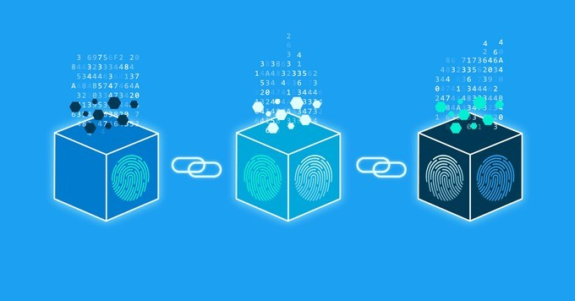
Introduction
A blockchain is a growing list of records, called blocks, that are linked using cryptography. Each block contains a cryptographic hash of the previous block, a timestamp, and transaction data.

Slide 7
Block Chain Video and answer simple question
https://www.youtube.com/watch?v=SSo_EIwHSd4&ab_channel=SimplyExplained
Hash Calculator
https://www.tools4noobs.com/online_tools/hash/

Slide 8
Types of Blockchain
Public BlockChain
Consortium Blockchain
Private Blockchain
Hybrid Blockchain

Slide 9
Architecture of Blockchain
Node — user or computer within the blockchain
Transaction — smallest building block of a blockchain system
Block — a data structure used for keeping a set of transactions which is distributed to all nodes in the network
Chain — a sequence of blocks in a specific order
Miners — specific nodes which perform the block verification process
Consensus— a set of rules and arrangements to carry out blockchain operations

Slide 10
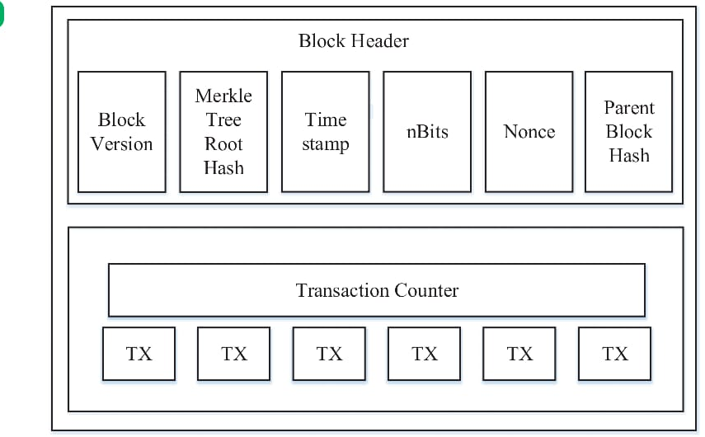
The inside of a Block https://www.researchgate.net/figure/Example-of-a-bitcoin-block-data-from-blockexplorercom_fig2_281773799 https://developer.bitcoin.org/reference/block_chain.html

Slide 11
BLOCKCHAIN
Blockchain is a growing immutable list of records, (immutable ledger) called blocks, that are linked together using cryptography. Each block contains cryptographic hash values of the previous block, a timestamp, and transaction data.
A blockchain is essentially a digital ledger of transactions that is duplicated and distributed across the entire network of computer systems on the blockchain. Each block in the chain contains a number of transactions, and every time a new transaction occurs on the blockchain, a record of that transaction is added to every participant’s ledger.

Slide 12
Blockchain Concepts:
◆
Transactions:
Transactions are data structures that encode the transfer of value between participants in a blockchain system. Each transaction is a public entry in the blockchain.
Transactions are a good way to describe any transfer of ownership, and the complete history of transactions is the key to identifying the current owners.
◆
Cryptography:
This is using the techniques of encryption and decryption to send and receive messages.
The major idea of cryptography is to protect data from being accessed by unauthorized people. Cryptography uses the concept of keys to protect data similar to the idea of locks and keys in physical world.
In blockchain, cryptography is attained in two ways; Symmetric Cryptography
and Asymmetric Cryptography.

Slide 13




Symmetric Cryptography and Asymmetric Cryptography
Symmetric Cryptography:
This is whereby a single secret key is leveraged for both encryption and decryption functions. The fact that only one key was used for both encryption and decryption which can create some security issues lead to invention of asymmetric
Message to be encrypted
Hello World
cryptography.
Encryptio n
SECRET KEY
#$#$#*&&^^
%^%$
Cypher text
Decryption
Hello World
Decrypted text

Slide 14


Symmetric Cryptography and Asymmetric Cryptography
◆
Asymmetric Cryptography /public-private-key cryptography.
In asymmetric cryptography, two complimentary keys are used during the encryption and decryption process. cypher text created with one of these keys can only be decrypted with the other key and vice versa.
Hello World
SECRET KEY
SECRET KEY
Complimentar y keys
#%*^
%^**&
*&#@%$
%#$
Complimentary keys
SECRET KEY
SECRET KEY
Hello World

Slide 15
There are two keys, together they form the pair of corresponding keys. One key is used for encryption and the other for decryption.
The trick to asymmetric cryptography is that you can never decrypt cypher text with the key that was used to encrypt it.
The two keys are called Private and public key.
◆
•
•

Slide 16
◆
Hashing, Hash pointer & Hash Value:
Hashing refers to the transformation and generation of input data of any length into a string of a fixed size.
In blockchain, every block is cryptographically tied to the next block.
A hash pointer is similar to a pointer, but instead of just containing the address of the previous block it also contains the hash of the data inside the previous block. Hashing is used in blockchain to compare and validate data authenticity.
Hash value is equivalent to a digital fingerprint .
◆
Blockchain Data Structure:
A block is considered to be the prime blockchain data structure. The different blocks in a blockchain are identified with the help of a hash in the block header.
Data structures help in the organization and storage of data in a way that they can be easily accessed and modified.

Slide 17
Peer to peer network
◆
Peer to peer network, commonly known as P2P is a decentralized network communications model that consists of a group of devices (nodes) that collectively store and share files where each node acts as an individual peer. In this network, P2P communication is done without any central administration or server, which means all nodes have equal power and perform the same tasks.
The P2P technology is based on a very simple principle, and that is the concept of decentralization. The peer-to-peer architecture of blockchain allows all cryptocurrencies to be transferred worldwide, without the need of any middle-man or intermediaries or central server
◆

Slide 18
Distributed System
◆ Distributed systems are a computing paradigm whereby two or more nodes work with each other in a coordinated fashion in order to achieve a common outcome and it's modeled in such a way that end users see it as a single logical platform. Conversely, a blockchain can be described as a continuously growing distributed ledger jointly maintained by multiple parties. Blockchain therefore heavily uses the concepts and elements of Distributed Systems.

Slide 19
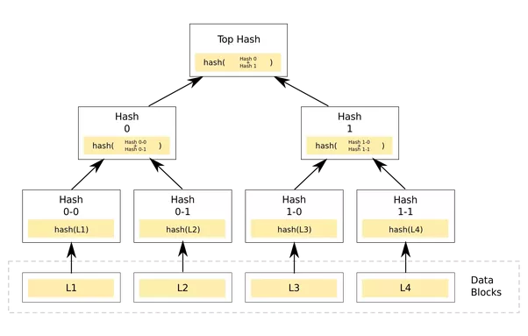

Slide 20
Here there are 4 transactions L1, L2, L3 and L4 in the block. All the transactions, as can be seen, are individually hashed. Eg L1 is hashed to hash 0–0. Then the combination of hash 0–0 and hash 0–1 is hashed and stored into a parent node, hash 0. Same goes for the other three transactions.
◆

Slide 21
Data Integrity
Proof-of-work
◆
a function to deter denial of service attacks and other potential spam on a network by requiring some level of work that is usually costly and timeconsuming. In the Bitcoin network, miners must complete a proof-of-work in order to regulate the rate at which new blocks are generated.

Slide 22
Distributed consensus
◆
A distributed consensus ensures a consensus of data among nodes in a distributed system or reaches an agreement on a proposal. A consensus algorithm may be defined as the mechanism through which a blockchain network reach consensus. Public (decentralized) blockchains are built as distributed systems and, since they do not rely on a central authority, the distributed nodes need to agree on the validity of transactions. This is where consensus algorithms come into play. They assure that the protocol rules are being followed and guarantee that all transactions occur in a trustless way, so the coins are only able to be spent once.

Slide 23
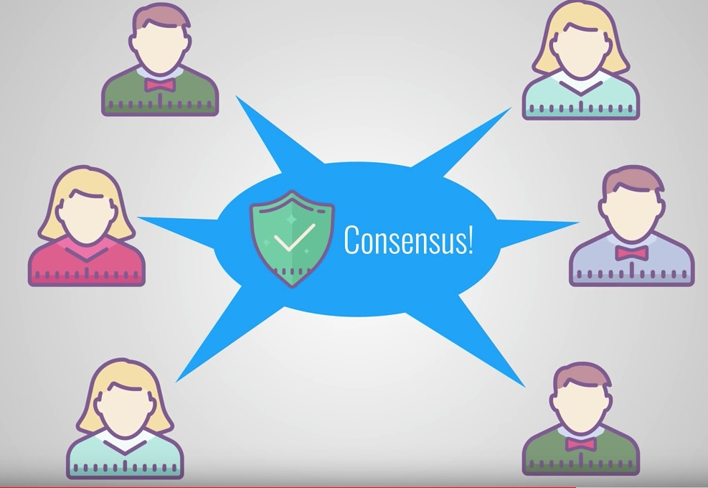
Distributed consensus

Slide 24
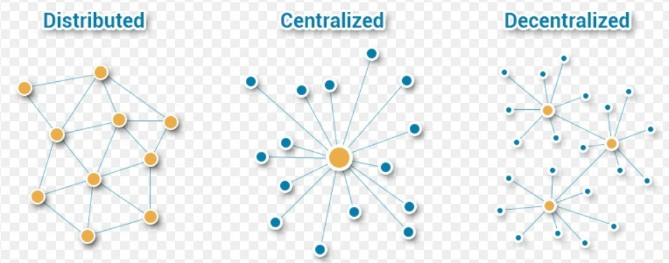
Software architecture and it’s relation to the Blockchain
◆
Centralized Systems
Distributed Systems (Advantages and Disadvantages)
Distributed Peer-to-Peer Systems
◆
◆

Slide 25
Decentralized Systems
◆
A blockchain can be either centralized or decentralized. It is important, however, that decentralized not be confused with distributed. While a blockchain is inherently distributed (meaning that many parties hold copies of the ledger), it is not inherently decentralized.
Whether a blockchain is centralized or decentralized simply refers to the rights of participants on the ledger, and is therefore a question of design.
In a decentralized network, anyone can participate and transact on the ledger. As a result, mechanisms must exist in order to combat the vulnerabilities that arise from this design and to ensure that transactions are correct
◆
◆

Slide 26
Distributed Ledger Technology (DLT)
◆
https://www.bosch.com/stories/distributed-ledger-technology/
◆
◆

Slide 27
Centralized Network
◆
A centralized network, on the other hand, is made up of parties whose identities are known. Thus, the system is valid because only credible and reputable participants can post to the ledger. Because participants’ identities are known, their transactions can therefore be audited.
Ultimately, a centralized distributed ledger should be used in any highly regulated industry - such as financial services – to minimize vulnerability.
While both decentralized and centralized blockchains have respective risks, a centralized network is much preferred for our purposes in that the identity of participants is known and, as a result, an audit trail exists should an actor attempt to corrupt the system.
◆
◆

Slide 28
Use-cases: Centralized vs Decentralized
◆
Payment Systems: All the currencies in the world that are operated by banks work on top of centralized servers. By doing so, they have full control over all the operations and also know about all your entire financial activities.
However, one of the worst things about using a centralized currency is that if someone gets hold of your bank credentials, they can easily access all your money and use it for their own benefit. Another disadvantage of centralized payment systems is that there can be a disruption or failure and you will not be able to access your funds when you need it.
In decentralized systems, as there is no central authority or point of failure, your funds are always available. It also removes the chance of your funds getting hacked or accessed by a malicious actor. Another benefit of the payment system is the removal of intermediate fees. The only fees that are associated with the process are either small or non-existent. They are also borderless and secure.
◆

Slide 29
Use-cases Centralized vs Decentralized
◆
Government Voting: The whole voting scenario is dealing with one most important issue, transparency. The current way of carrying out the vote doesn’t take transparency into account. That’s where a decentralized voting platform can come into rescue. Governments can use it to run the votes and provide transparent voting. By using a transparent voting system or a voting system running on a decentralized network, the voters can easily verify the votes. This also means that no party can do frauds when it comes to counting of votes.
Another benefit of using this approach is that results can be declared as soon as voting is finished.
Energy: Centralized entities mainly control and distribute the energy who decide where they want to provide their services and at what price. To solve this, decentralization can come up with a unique solution. It can use a decentralized power grid, which you can use to cut the middleman. It also provides equal opportunity to everyone who wants to get energy or generate energy and then sell it to others.
◆

Slide 30
Hands-on Exercise
Install Go
https://go.dev/doc/tutorial/getting-started
Run Hello World Program

Slide 31
Hands-on Exercise 2
Directly Try Go:
https://go.dev/
Try PoW
https://www.geeksforgeeks.org/math-pow-function-in-golang-with-examples/#:~:text=Pow()%20Function%20in%20Golang%20With%20Examples,-View%20Discussion&text=Go%20language%20provides%20inbuilt%20support,provided%20by%20the%20math%20package.

Slide 32
Hands-on Exercise 3
Directly Try Go:
https://go.dev/
Try creating a basic Block Chain
https://dev.to/nheindev/build-the-hello-world-of-blockchain-in-go-bli
Code:
https://github.com/tensor-programming/golang-blockchain/blob/master/main.go

Slide 33
Why Blockchain is Needed
Trust and Integrity in Peer-to-Peer Systems.
◆
In the context of software systems, integrity is a nonfunctional aspect of a system to be safe, complete, consistent, correct, and free of corruption and errors
Trust is the firm belief of humans in the reliability, truth, or ability of someone or something without evidence, proof, or investigation.
People will join and continue to contribute to a peer-to-peer system if they trust it and if the results of interacting with the system on an ongoing basis confirm and reinforce their trust. In order to fulfill the expectations of the users and reinforce their trust in any system, integrity of the system is required.
As soon as people lose trust in a peer-to-peer system, they will abandon it, which in turn will cause the system to terminate eventually.
◆
◆
◆

Slide 34
Why Blockchain is Needed
Integrity in a purely distributed system depends on a variety of factors, some of the most important factors include:
❑
Knowledge about the number of peers.
Knowledge about the trustworthiness of the peers.
❑
If the number of peers as well as their trustworthiness is known, the chances of achieving integrity in a distributed system are higher. However, if the number of peers and their trustworthiness is unknown, the chances of achieving integrity are lower. This is the case when running a purely distributed peer-to-peer system on the Internet that is open to everyone.
Integrity Threats in Peer-to-Peer Systems
For simplicity purposes, we will consider two major integrity threats in the peer-to- peer systems. These are:
◆
Technical failure. Malicious peers.
◆

Slide 35
Why Blockchain is Needed
Technical Failures.
All hardware and software components of a computer system as well as any component of the computer network have the risk of failing and creating errors. Hence, any distributed system has to face the problem that its components may fail or produce wrong results by chance.
Malicious Peers.
This source of untrustworthiness is caused by the goal of individuals who decide to exploit the system for their own purposes. Malicious peers comprise the most severe threat as they attack the foundation on which any peer-to-peer system is built: trust.
The Core Problem to Be Solved by the Blockchain.
The core problem to be solved by the blockchain is achieving and maintaining integrity in a purely distributed peer-to-peer system that is comprised of an unknown number of peers with unknown reliability and trustworthiness.

Slide 36

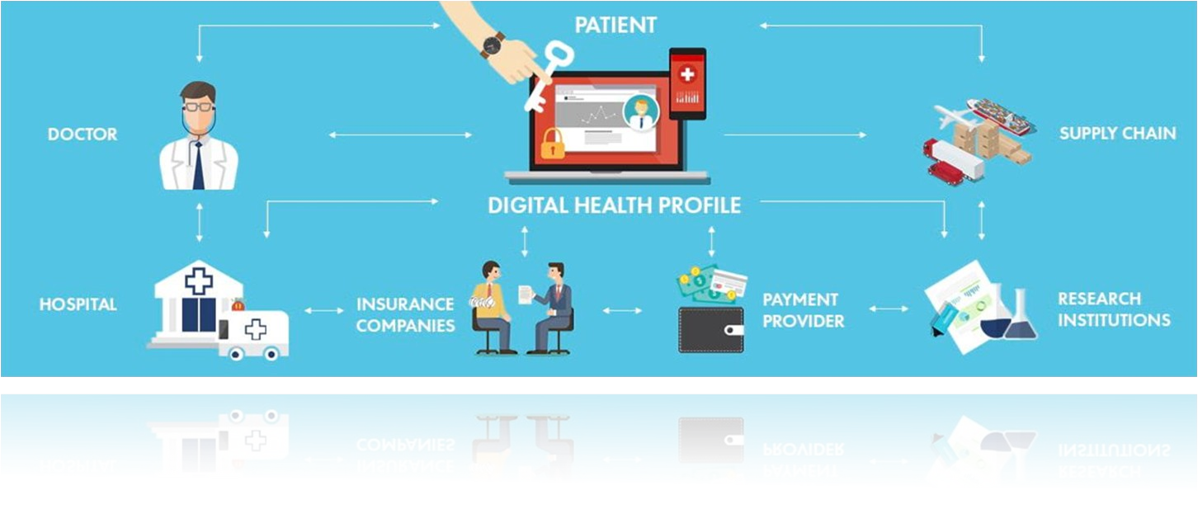

Slide 37

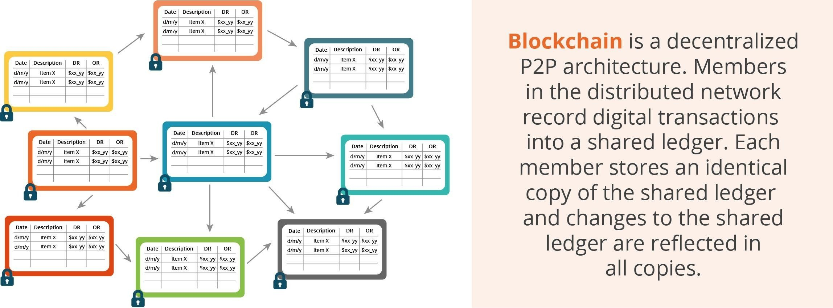
Source: Laura A Linn and Marta B. Koo, Blockchain For Health Data and Its Potential Use in Health IT and Health Care Related Research

Slide 38
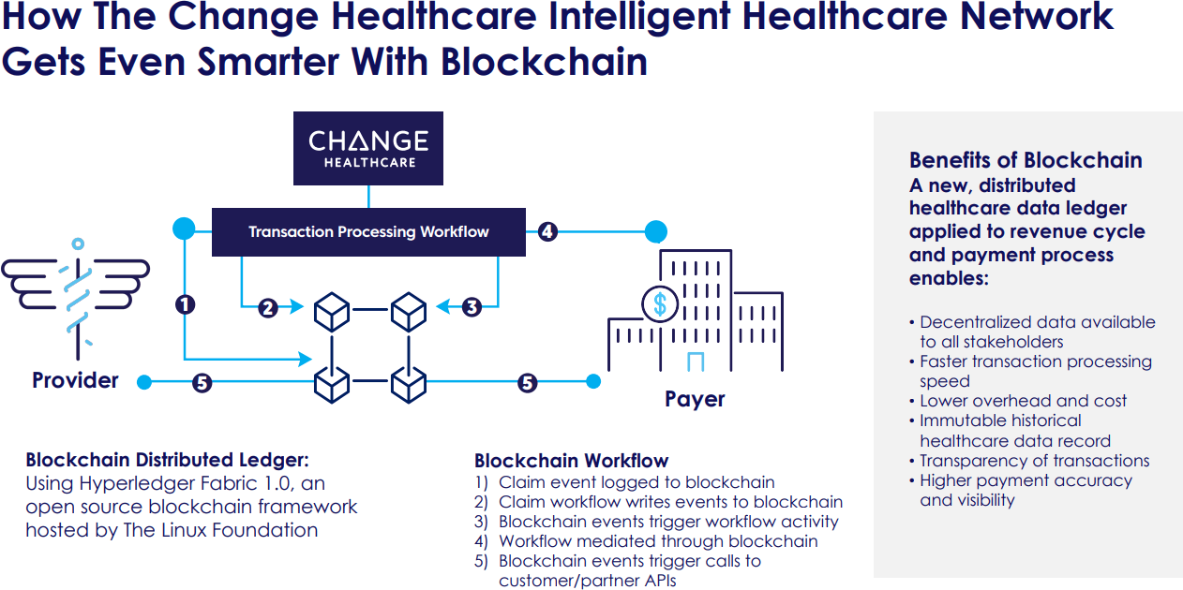
Healthcare Services

Slide 39
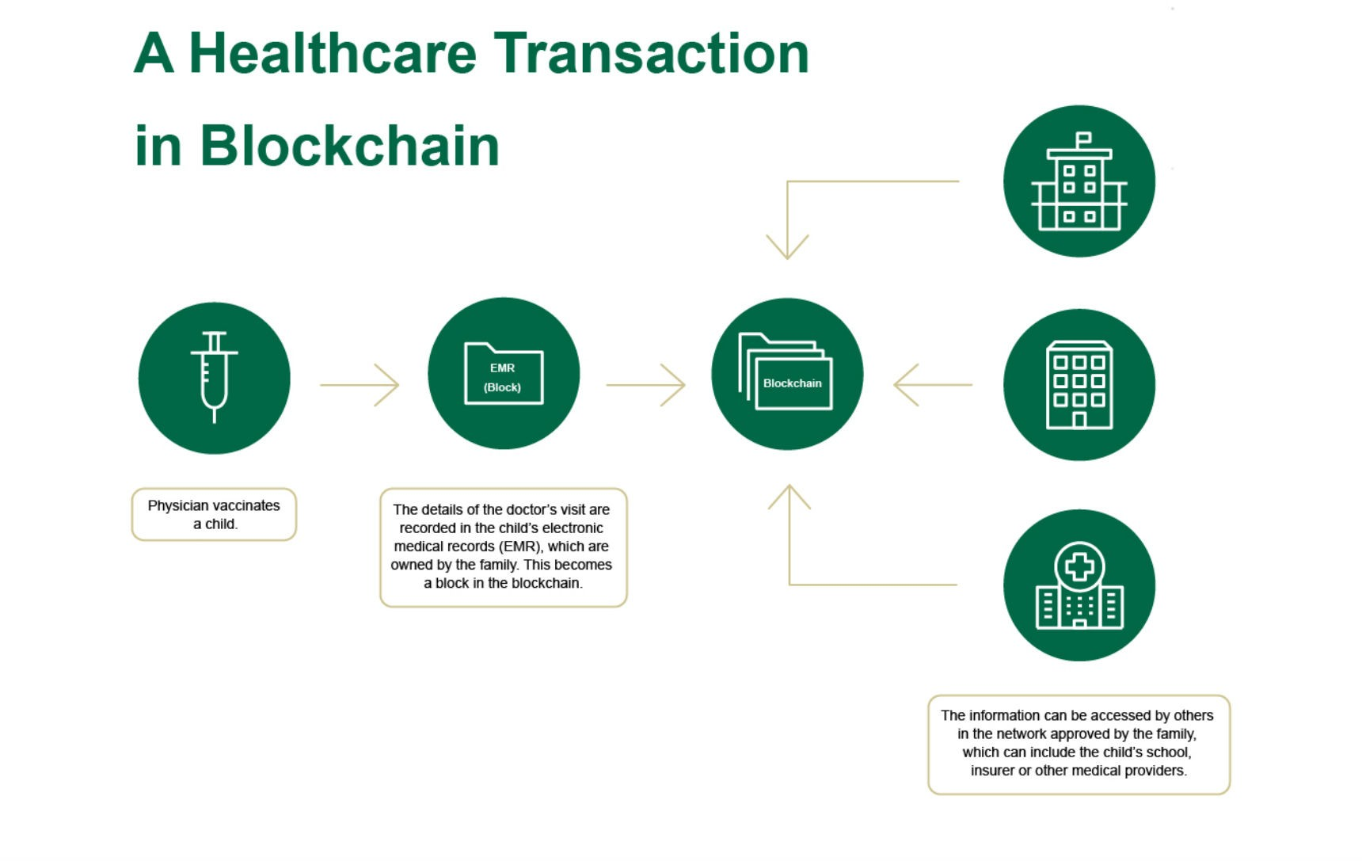
Physician vaccinates a child.
The details of the doctor’s visit are recorded in the child’s electronic medical records (EMR), which are owned by the family.
This becomes the block in the blockchain.
The information can be accessed by the others in the network approved by the family, which can include the child’s school, insurer or other medical providers.

Slide 40
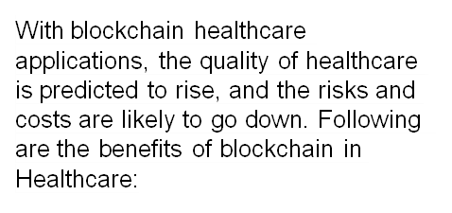
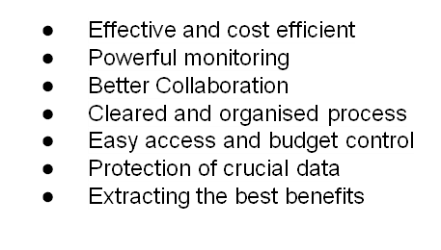
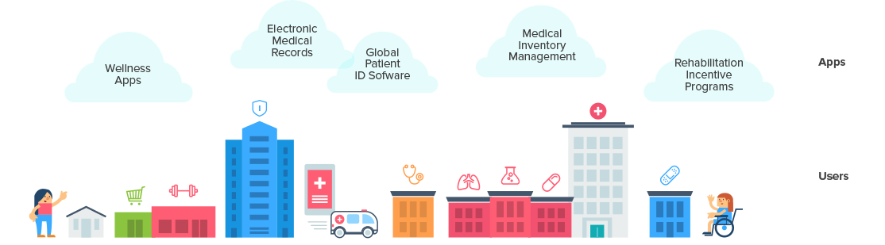

Slide 41
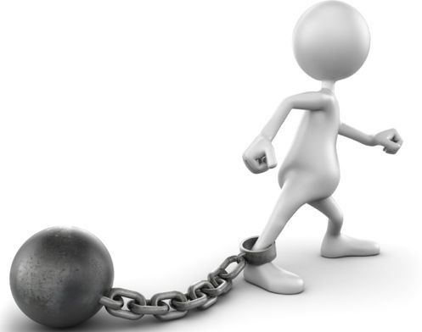
New technology – It’s still in its nascent stage and even large corporations are struggling to integrate it into their core systems.
High initial cost - The high buy-in for the technology coupled with the huge amount of processing power required to keep it up is proving to be
a deterrent.
Not able to handle large data sets – Although it can handle personal data like IDs and certificates, large data like CT scans will be difficult to store in blockchains
●
●

Slide 42

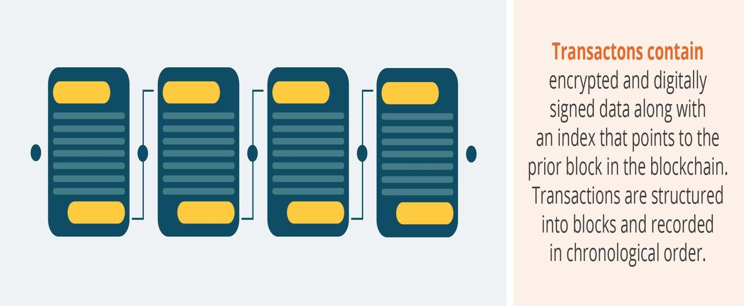
Encryption
Source: Laura A Linn and Marta B. Koo, Blockchain For Health Data and Its Potential Use in Health IT and Health Care Related Research
8

Slide 43

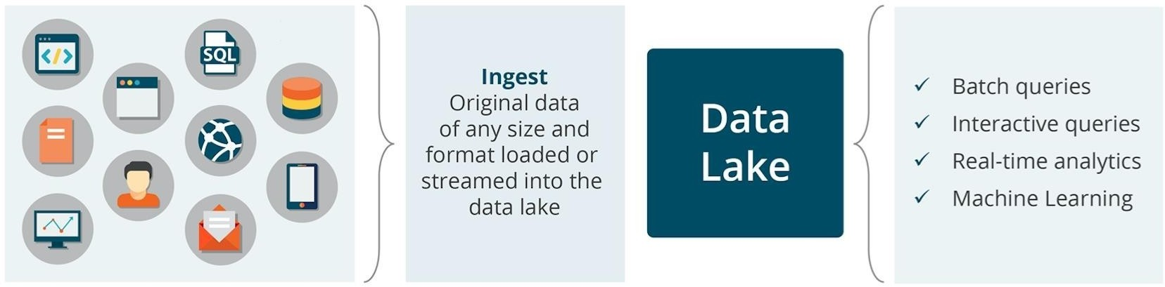
Source: Laura A Linn and Marta B. Koo, Blockchain For Health Data and Its Potential Use in Health IT and Health Care Related Research
9

Slide 44


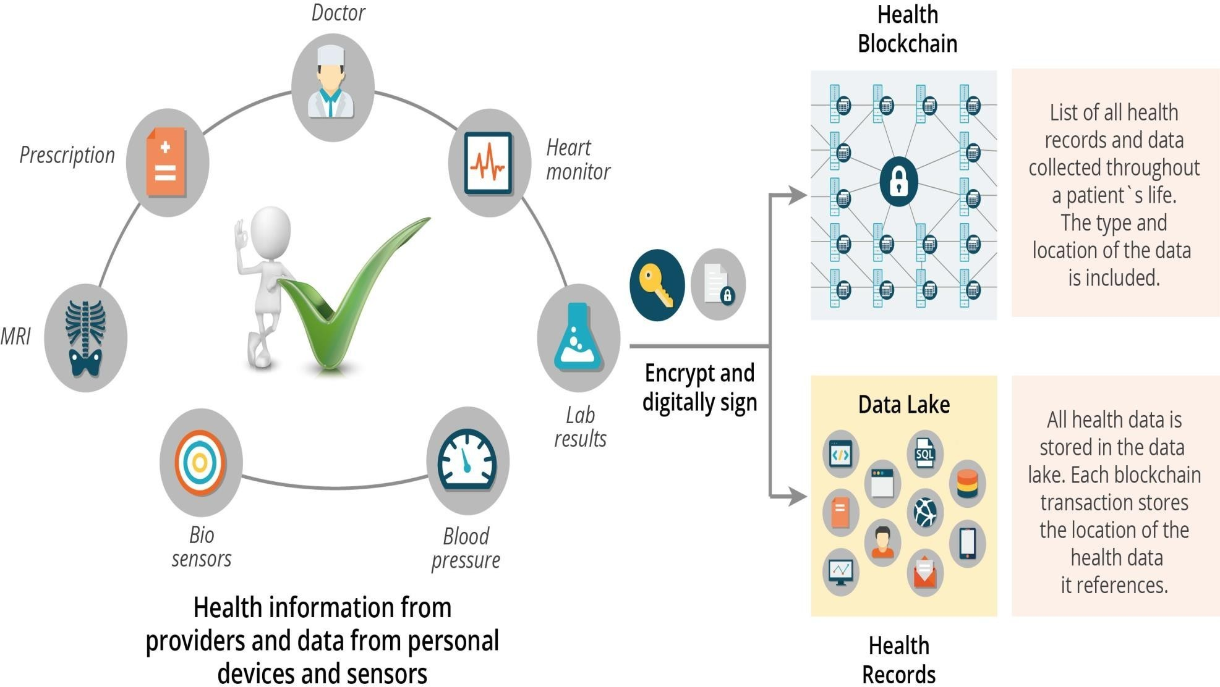
Source: Laura A Linn and Marta B. Koo, Blockchain For Health Data and Its Potential Use in Health IT and Health Care Related Research
10

Slide 45
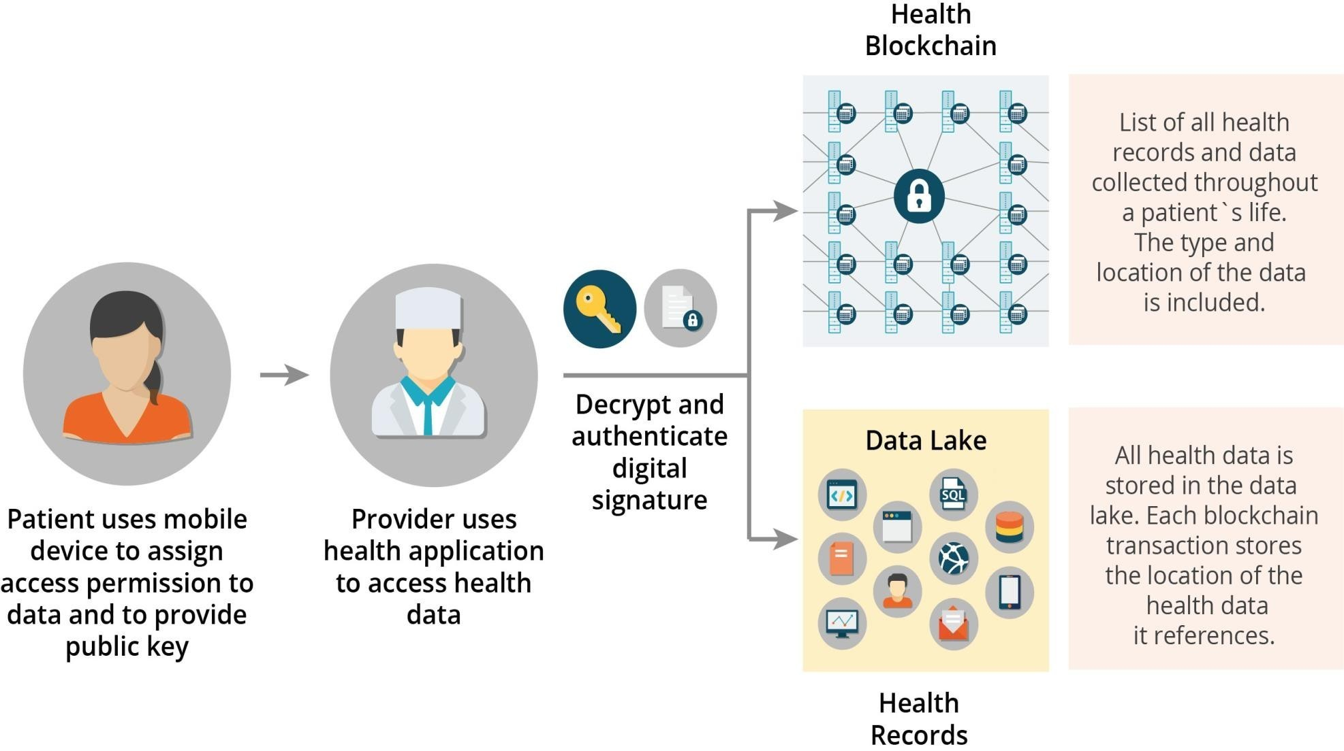
Source: Laura A Linn and Marta B. Koo, Blockchain For Health Data and Its Potential Use in Health IT and Health Care Related Research

Slide 46
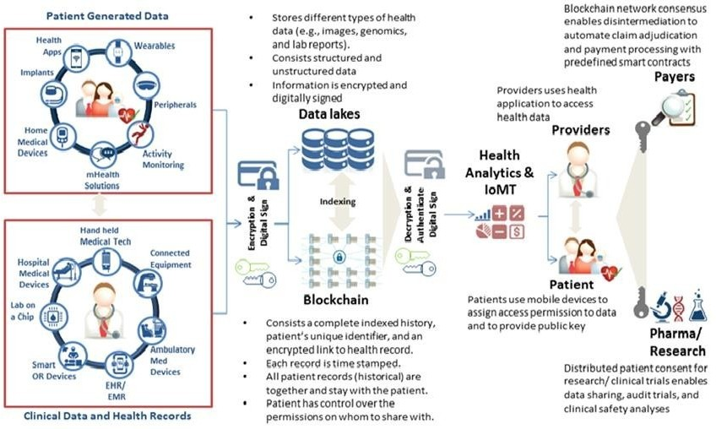
Source: Laura A Linn and Marta B. Koo, Blockchain For Health Data and Its Potential Use in Health IT and Health Care Related Research
12

Slide 47
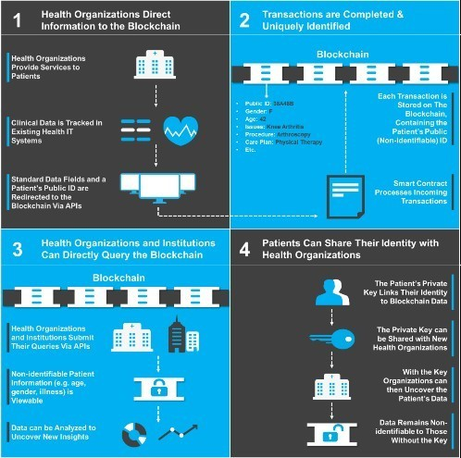
Source: Deloitte, Blockchain: Opportunities for Health Care (Aug. 2016).
13

Slide 48

Blockchain technology offers many advantages for health care IT.
▪
▪
Blockchain is based on opens source software, commodity hardware, and Open API’s.
These components facilitate faster and easier interoperability between systems and can efficiently scale to handle larger volumes of data and more blockchain users.
The architecture has built-in fault tolerance and disaster recovery, and the data encryption and cryptography technologies are widely used and accepted as industry standards.
The health blockchain would be developed as open-source software.
▪
▪
▪
14

Slide 49

Open-source software is peer-reviewed software developed by experts
▪
.
It is reliable and robust under fast changing conditions that cannot be matched by closed, proprietary software.
Open-source solutions also drive innovations in the applications market. Health providers and individuals would benefit from the wide range of application choices and could select options that matched their specific requirements and needs.
Blockchain technology offers many advantages to medical researchers,
▪
▪
▪
15

Slide 50

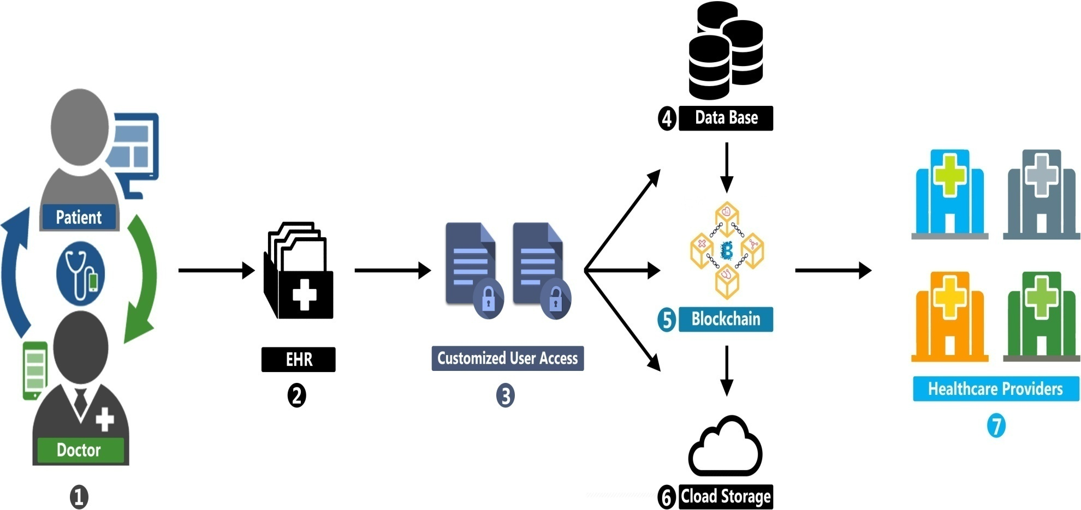

Slide 51

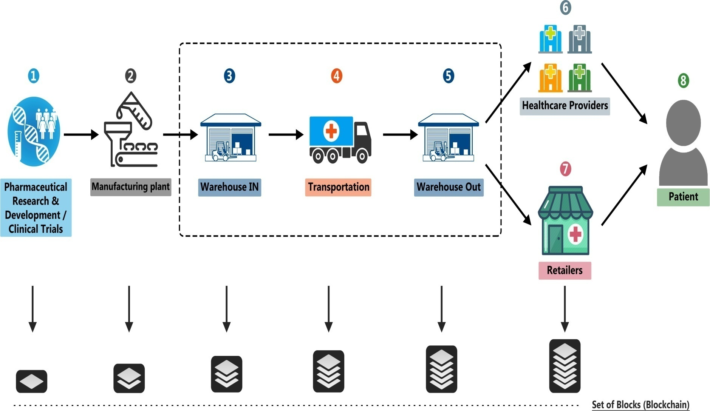

Slide 52

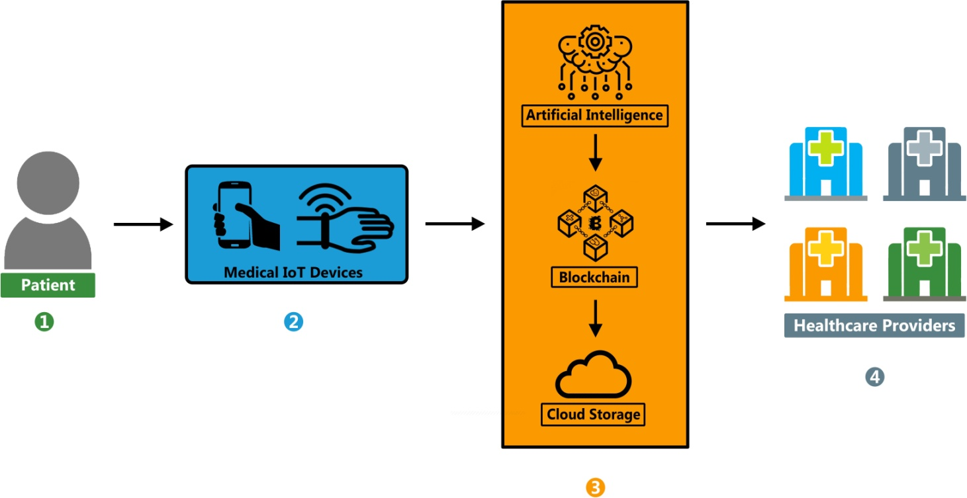

Slide 53

Blockchain has the potential to substantially impact the health care industry as a whole and payers, providers and patients with respect to drug traceability, clinical trials and research, and data management.

Slide 54

•
•
•
•
•
Blockchain provides security in the process Manufacturer marks with a unique code
# is produced for the drug (contains all relevant information) The drug information is stored on the blockchain
Each time the drug is moved in the process, that information is stored on the blockchain – wholesaler verifies and sends to pharmacist, pharmacist delivers to the patent

Slide 55

•
•
Mistakes or fraud may occur
Considerable amounts of data are produced from the trials themselves including safety, efficiency and quality data
Many people will “touch” this data
Data collection may not be standardized
Outcome switching, data dredging and selective publication of results may occur and may also affect protocol development
•

Slide 56

Blockchain can provide authentication and prevent modification:
Provides proof of existence for and verification of trial data and transparency
Would include the trial protocol, results, site information, required consents, etc.
Allows reproducibility and secure data sharing among research communities
Trial protocol may have a unique signature recorded on the blockchain

Slide 57

Allows the creation of a system to record and verify clinical trials as specified by the parties conducting the trials and prevents modifications
•
o
Uses an entry from study protocol on clinicaltrials.gov and a text file
with pre-specified end points and planned analysis
o
Then converted into SHA-256 hash calculator which was then used as a private key for a Bitcoin wallet, followed by a public key to enable transactions

Slide 58

Managing patient data requires complete access the individual medical records to be shared among various clinicians and other professionals and to and from various locations.
ºNo standards for collection, storage or disclosure of such information
ºSocial networks and physician portals are not always secure
ºPatients do not control their data

Slide 59

Blockchain can provide a secure structure:
ºUsers share information
ºInformation can be stored in smart contracts containing permissions and conditions for release
ºPatients control access – private keys unlock access or third parties authorized by the patients can do so
ºCan pull in other information from wearables and registries
ºCompanies are building personal health records (PHR) to align all stakeholders through patient engagement platforms and utilizing blockchains to implement

Slide 60
Blockchain can:
•
Address patient consent for data sharing not addressed by HIEs Provide more tailored consents and update as desired
Create a system of “smart contracts” for a rule-based method for access
o o o

Slide 61
Store certain data on the blockchain but still allow certain data to be accessed by secure links:
ºOn blockchain data could include age, gender and other personally identifiable information; be of the size and type to be stored and be immediately viewable
ºOff blockchain data could include images and medical notes of any size or format that may have different requirements for the need to view.

Slide 62
Blockchain could also collect information from web-based and mobile applications or other devices and becomes very important for digital health
Development and other costs, concern of patients, scability, storage limits and capacity are obstacles to be addressed

Slide 63

Blockchain may also be used for: provider licensing and credentialing; payer administration and data exchange for value- based care; supply chain management and medication monitoring; public health surveillance and population health management; Revenue cycle management and fraud prevention.

Slide 64

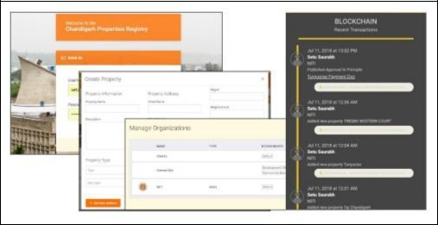
1. Land Records:

Slide 65
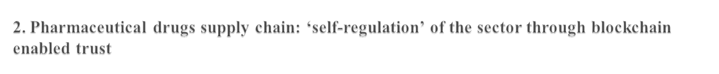
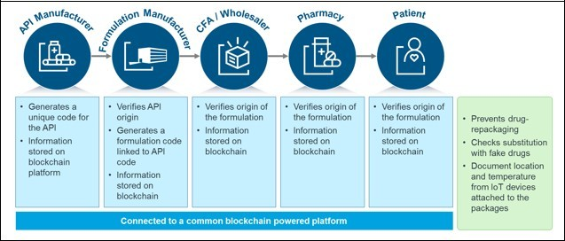

Slide 66
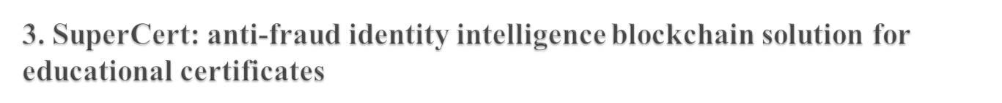
Creation of student identity – Superidentity. A unique blockchain representation of the identity is provided, along with a set of public and private keys.


Issuance of certificate by university, together with Superidentity of the student.

SuperCert i.e. creation of a block of student certificate – hashed version of the certificate on the blockchain

Verification of the certificate using the public key of the student and the public key of the university. The solutions have features for both online and offline verification.

Slide 67

Immunization Supply Chain: Building A New Immunization Infrastructure for India - Unified and Enhanced by Blockchain
Chit Funds: A blockchain based model to enhance trust and unlock value creation Insurance (Medical, Automotive, etc.)




Organic Farming
EV Battery Swapping Energy Trading
Crytocurrencies for NGO donation




Slide 68

 http://blog.appliedinformaticsinc.com/blockchain-transparency- integrity-and-clarity-to-the-healthcare-system
 https://www.healthit.gov/sites
 www.niti.gov.in
 www.ibm.com
 www.deollite.com

Slide 69
Blockchain P2P Network
◆
Digital signatures(public and private keys) securely ensure a party’s identity is kept private and digital asset is securely stored. This is still not enough.
We need to understand how blockckain uses the peer to peer network to solve perhaps the biggest problem when it comes to digital assets, the double-spending problem.
When using fiat money, the paper is convertible i.e once you give the paper away, you cannot spend it again.
In cryptocurrency, what happens if you prove ownership and send digital assets twice at the same exact time?
Hackers can try to reproduce digital assets as well as double them.
Cryptocurrency had to solve this issue before being accepted officially as currency.
◆
◆
◆
◆
◆

Slide 70
Blockchain P2P Network
◆
Double Spending Problem – Fowarding information to elements in a distributed peer to peer system requires time. Because not all peers have the updated information at a given time, they are prone to be exploited by anyone who already has the latest information. Hence one can transfer ownership of a digital asset more than once.

Slide 71
Blockchain P2P Network
◆
To understand this network, we look at how the cryptocurrency P2P network works. We will explore different blockchains policies specifically and the P2P network in general by breaking the P2P network into five layers: Consensus Layer, Miner Layer, Propagation Layer, Semantic Layer and the Application Layer.
1. Consensus Mechanism
A consensus mechanism is an agreement needed for the network to operate properly even in the event of a failure. It needs to be able to achieve agreement on the data of the network within the distributed P2P network.
In cryptocurrencies, the consensus/agreement is on whether the blocks are valid or not. If a block is valid, the block will be added to the blockchain. If a block is invalid, it will be rejected from being added to the blockchain.
◆
◆

Slide 72
Blockchain P2P Network
◆
That’s where a consensus policy comes into play. Most of the peers in the network hold the same blocks in their validated best blockchain and follow the same rules (consensus rules); that’s how blockchain ensures security.
The P2P network enables a ledger. To achieve this goal in a secure way, the P2P network stores the digital ledger rules and security. The consensus mechanism provides not only the rules but also the incentives to do the work of storing the data and creating transactions by giving the reward to miners.
◆
Proof of work(A concensus mechanism)
◆
PoW is achieved by having a network of miners and presenting the miners with a mathematical problem.

Slide 73
Blockchain P2P Network
◆
When miners solve a problem, they are rewarded with a cryptocurrency
A reward is given to the first miner who solves the problem. Then the verified transactions are stored in the public ledger.
◆
2. Mining Layer
What miners are doing behind the scenes is the network bookkeeping.
For bitcoin and most coins out there that utilize PoW, each peer needs to hold the entire public ledger, which holds a record of all the transactions that were ever conducted.
For bitcoin, transactions must be validated by the miners who check the ledger, ensure the sender is not transferring funds it doesn’t have, only then add the transaction to the ledger
◆
◆

Slide 74
Blockchain P2P Networks
◆
Finally, to ensure protection from hackers, the miners seal these transactions behind multiple layers of computational work, requiring too much work for a hacker to possibly achieve. This service is rewarded by providing bitcoins as a fee to the miner.
3. Propagation Layer
◆
The propagation layer is responsible for deciding how the shared ledger and the blocks are transmitted on the P2P network.
Each of the peers can transmit a new transaction to other nodes on the network. This architecture allows nodes to communicate indirectly. For instance, you can send a transaction affecting two wallets without each wallet being connected directly to each other.
Any node that receives a valid transaction it has not seen before will immediately forward it to all other nodes to which it is connected.
◆
◆

Slide 75
Blockchain P2P Networks
4. Semantic Layer
◆
The semantic layer takes care of how new blocks relate to previous blocks and provides the protocol for verifying the consensus rules.
In this layer, transactions happen where coins/tokens are transferred between accounts.
The consensus in the blockchain holds the same blocks in their validated best block chain and follows the same rules (consensus rules).
◆
◆

Slide 76
Blockchain P2P Networks
5. Application Layer
◆
This layer takes care of deploying applications on top of the blockchain.
For instance, dapps, smart contracts, exchanges, and sites that provide information about a blockchain are applications built on top of blockchains.
For the application layer, the blockchain needs to expose APIs.
Bitcoin offers a full node, which is currently about 27 GB and includes a fully enforced node and all the rules of the blockchain. That is needed for mining as well as ensuring the peer you run that gets connected to the application layer is synced with the latest blocks.
These full nodes contribute to the functionality of the P2P network and help support the network and its security.
◆
◆
◆
◆

Slide 77
History Of Blockchain
The first work on a cryptographically secured chain of blocks was described in 1991 by Stuart Haber and W. Scott Stornetta
In 1992, Bayer, Haber and Stornetta incorporated Merkle trees to the design, which improved its efficiency by allowing several document certificates to be collected into one block.
The first blockchain was conceptualized by a person (or group of people) known as Satoshi Nakamoto in 2008.
In August 2014, the bitcoin blockchain file size, containing records of all transactions that have occurred on the network, reached 20 GB (gigabytes).
In January 2015, the size had grown to almost 30 GB, and from January 2016 to January 2017, the bitcoin blockchain grew from 50 GB to
100 GB in size.

Slide 78
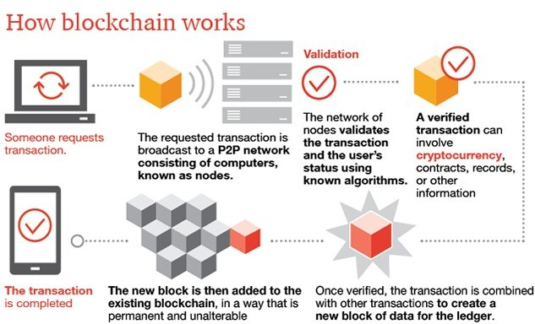
Working of Blockchain

Slide 79
Types of Consensus Algorithms
Proof-of-Work (PoW) used by BitCoins
Proof-of-Stack (PoS) used by Ethereum
Delegated Proof-of-Stack
Byzantine Fault Tolerance (BFT)
Practical Byzantine Fault Tolerance (PBFT)
SIEVE
Proof-of-Burn (PoB) and a few more

Slide 80
Types of Consensus Algorithms
Proof-of-Work (PoW) used by BitCoins
Proof-of-Stack (PoS) used by Ethereum
Delegated Proof-of-Stack
Byzantine Fault Tolerance (BFT)
Practical Byzantine Fault Tolerance (PBFT)
SIEVE
Proof-of-Burn (PoB) and a few more

Slide 81
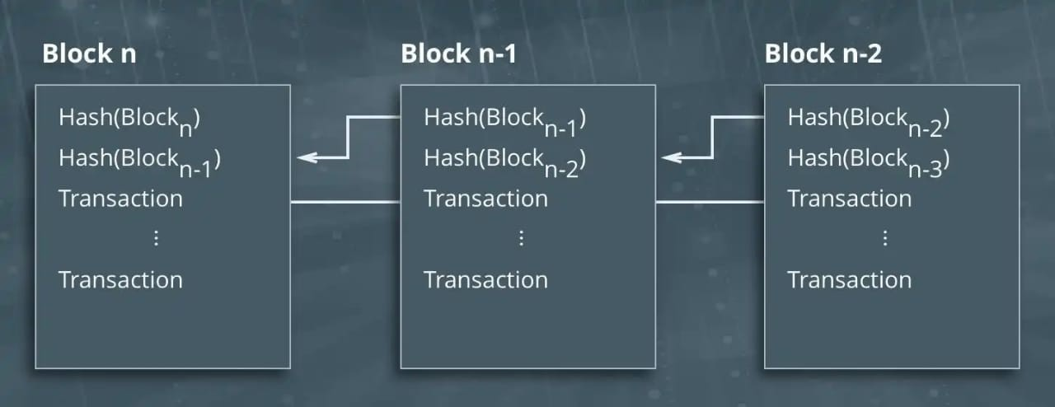
What is PoW Algorithm?
Proof-of-Work algorithm is used to confirm transactions and produce new blocks to the chain. Here miners compete against each otherto complete transactions on the network and get rewarded.

Slide 82
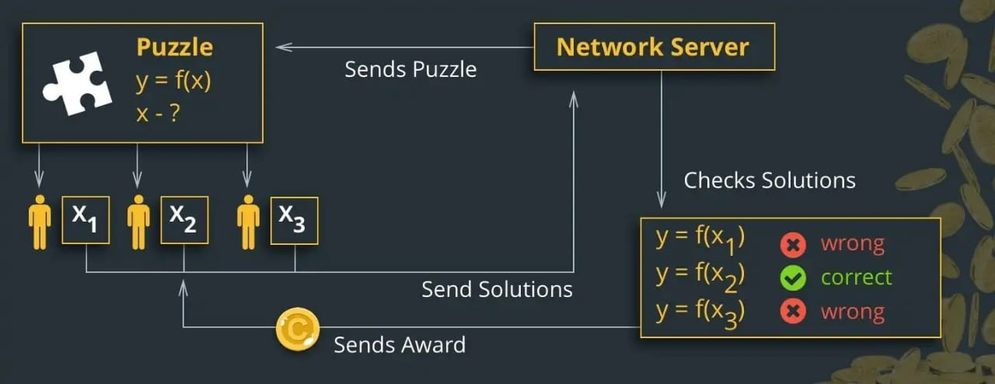
Working Of PoW
Miners solve the Puzzle, form the new Block and Confirm the Transaction in the following way

Slide 83
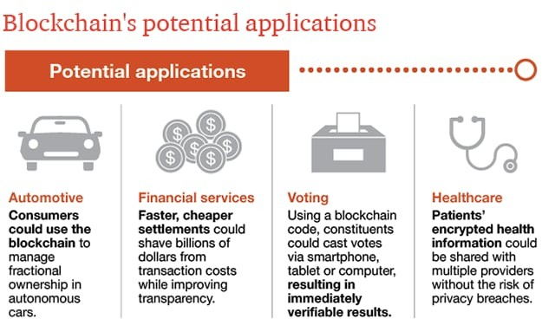
Applications Of Blockchain

Slide 84
Advantages
Disadvantages
•
•
•
•
•
•
•
Decentralized system Transparent
Secure
Faster and cost effective Store timeline data
No downtown User empower
•
•
•
•
Complexity
Size of Blockchain Need more resources Human errors

Slide 85
Conclusion
Blockchain is a new name in the world of technologies but it is definitely the one to last. Even in the early stages, the technology has gained huge popularity starting with their very first application of cryptocurrencies. More areas of applications are being discovered and tested with each passing day. Once the technology is adopted and accepted on a global level, it’ll transform the way we live today.

